Slide 1

SC Leadership Academy for Tobacco-Free Recovery State Strategy Session
South Carolina Department of Alcohol and Other Drug Abuse Services
Ashley Bodiford, MPH, MS, CSPS, ICPS
Region 2 Capacity Coach
Reston Hartsell, MS-MPH
Synar/Tobacco Prevention Coordinator

Slide 2


Objectives
South Carolina Department of Alcohol and Other Drug Abuse Services
Provide a brief overview of the SC Leadership Academy for Tobacco-Free Recovery State Strategy Session
Discuss the baselines measures and selected targets
Discuss DAODAS’s commitments
Discuss How The 301 System Can Strengthen Our Efforts

Slide 3

What are Leadership and Policy Academies?
South Carolina Department of Alcohol and Other Drug Abuse Services
SAMHSA-supported strategic planning sessions, which help state, local, tribal, and federal entities improve their services to those with and at risk for substance use and mental health disorders.
Goals of Academies Include:
  Incorporating evidence-based practices
  Increasing interagency collaboration and communication
  Improving system capacity and eliminating system gaps
  Increasing access to the most appropriate care

Slide 4
Participating Organizations
South Carolina Department of Alcohol and Other Drug Abuse Services
Alliance for a Healthier South Carolina
Fairfield Behavioral Health
G. Werber Bryan Psychiatric Hospital
Hold Out the Lifeline
Lexington/Richland Alcohol and Drug Abuse Council
Morris Village Alcohol and Drug Addiction Treatment Center
National Council for Behavioral Health (NBHN)
Substance Abuse and Mental Health Services (SAMHSA)
Select Health of South Carolina
Smoking Cessation Leadership Center
South Carolina Department of Alcohol and Other Drug Abuse Services
South Carolina Department of Health and Environmental Control
South Carolina Department of Health and Human Services
South Carolina Department of Mental Health
South Carolina Department of Social Services
South Carolina Office of Rural Health
South Carolina SHARE
South Carolina State Housing Finance and Development Authority
South Carolina Tobacco-Free Collaborative
South Carolina Youth Suicide Prevention Initiative
Three Rivers Behavioral Health
University of South Carolina

Slide 5
What does our baseline data tell us?
South Carolina Department of Alcohol and Other Drug Abuse Services
Behavioral Causes of Death in the U.S.
Sources:U.S. Department of Health and Human Services. The Health Consequences of Smoking: 50 Years of Progress. A Report of the Surgeon General. Atlanta, GA: U.S. Department of Health and Human Services, Centers for Disease Control and
Prevention, National Center for Chronic Disease Prevention and Health Promotion, Office on Smoking and Health, 2014. Printed with corrections, January 2014.
Mokdadet al,JAMA2004; 291:1238-1245
Mokdadet al;JAMA. 2005; 293:293
Notes:
Possibly take away some material to be within the 15-20 minute window. Also, we may want to add in some quotes from the Tobacco Treatment for Persons With Substance Use Disorders toolkit.

Slide 6
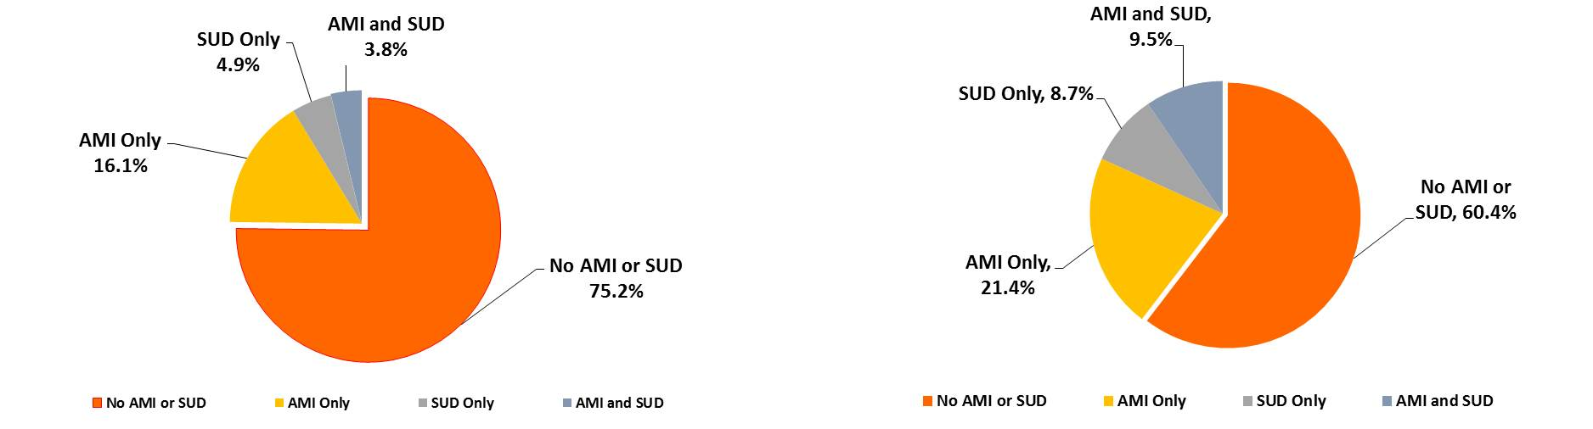
South Carolina Department of Alcohol and Other Drug Abuse Services
Smoking and Behavioral Health, U.S.
About 25% of the population is smoking nearly 40% of all cigarettes.
Figure 1. Any Mental Illness (AMI) or Substance Use Disorder (SUD) in the Past Year among Adults 18 or older: 2009-2011
Figure 2. Percentage of Cigarettes Smoking in the Past Month among Adults 18 or Older, by Any Mental Illness (AMI) or Substance Use Disorder (SUD) in the Past Year: 2009-2011
Any Mental Illness (AMI) is the Past Year is defined in the NSDUH survey as currently or at any time in the past 12 months having had a diagnosable mental, behavioral, or emotional disorder (excluding developmental and substance use disorders) of sufficient duration to meet diagnostic criteria specified within the Diagnostic and Statistical Manual of Mental Disorders (DSM-IV; American Psychiatric Assoc., 1994). The NSDUH Report (SAMHSA), March 20, 2013. Available at: http://media.samhsa.gov/data/spotlight/spot104-cigarettes-mental-illness-substance-use-disorder.pdf
Notes:
Possibly take away some material to be within the 15-20 minute window. Also, we may want to add in some quotes from the Tobacco Treatment for Persons With Substance Use Disorders toolkit.

Slide 7
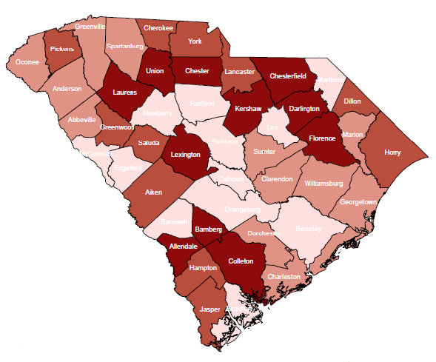
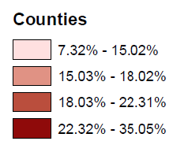
South Carolina Smoking Prevalence by County, 2015
South Carolina Department of Alcohol and Other Drug Abuse Services
Source: SC DHEC Adult Tobacco Survey
Notes:
Possibly take away some material to be within the 15-20 minute window. Also, we may want to add in some quotes from the Tobacco Treatment for Persons With Substance Use Disorders toolkit.

Slide 8
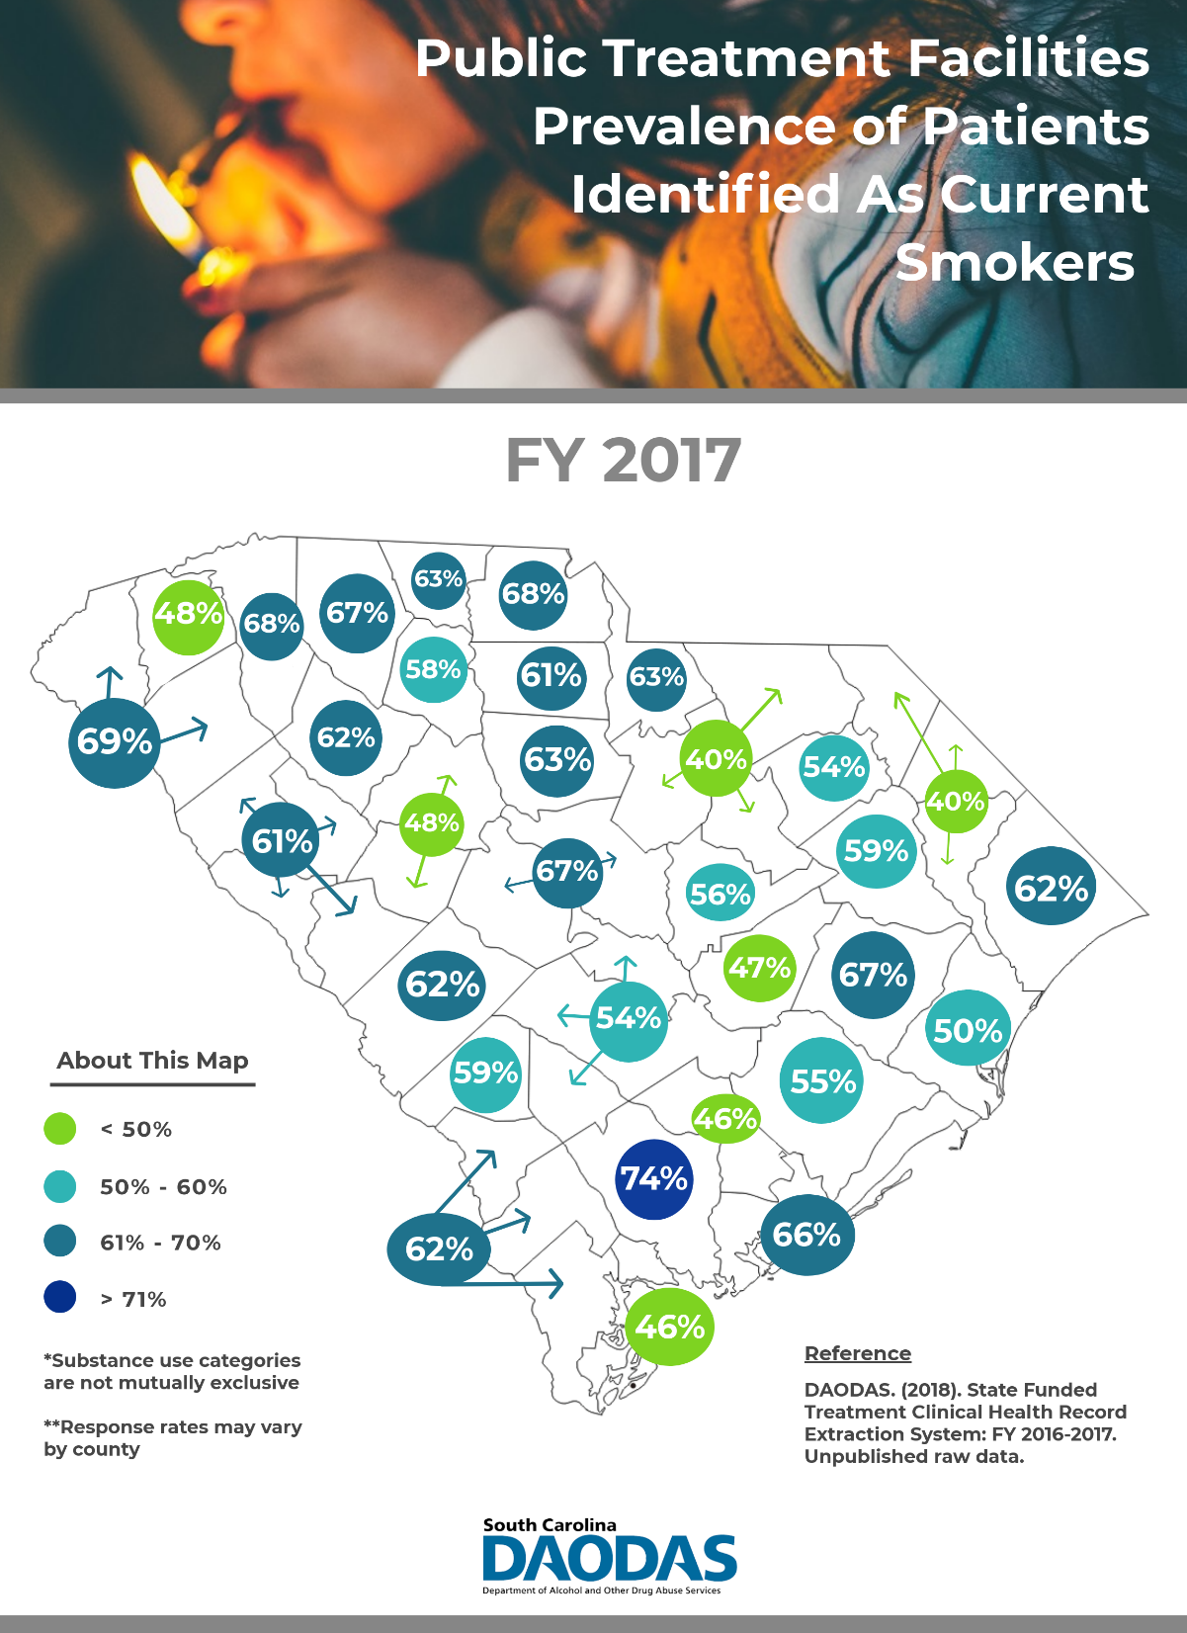
Notes:
Possibly take away some material to be within the 15-20 minute window. Also, we may want to add in some quotes from the Tobacco Treatment for Persons With Substance Use Disorders toolkit.

Slide 9
First Baseline and Target
South Carolina Department of Alcohol and Other Drug Abuse Services
*MH-related principal diagnosis includes any mental illness except for dementias, developmental delays, and intellectual disabilities (Average N=48,570)
Source: SC MMIS 2018

Slide 10
Second Baseline and Target
South Carolina Department of Alcohol and Other Drug Abuse Services
*SUD-related principal diagnosis includes all substances except for nicotine/tobacco (Average N=11,100)
Source: SC MMIS 2018

Slide 11
How will we get there? How will we know if we are getting there?
South Carolina Department of Alcohol and Other Drug Abuse Services
Interagency Coordination and Collaboration
Legislative Policy
Policy
Behavioral Screenings for Referral
Provider Education
Smoke-Free Policies
Systems Change - EHR
Advocacy
Cessation Coverage
Marketing
Partnership Development
MCO Strategies
Communication

Slide 12
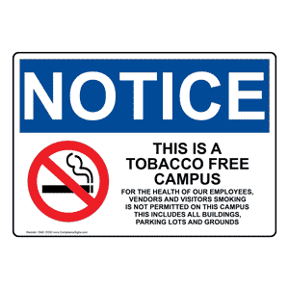


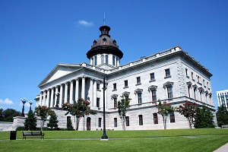
Four Strategy Committees
South Carolina Department of Alcohol and Other Drug Abuse Services
Policy and Systems Change
Provider Education and Engagement
Partner Development
Legislative Policy

Slide 13
Policy and Systems Change Committee
South Carolina Department of Alcohol and Other Drug Abuse Services
Implementation Team: Sharon Biggers, Maudra Brown, Heather Kirby, Ashley Bodiford, Veronica Edmonds, Reston Hartsell, Doug Tipperman, Hellen Dekle, Brian Clark Committee Co-Liaisons: Sharon Biggers and Maudra Brown
Objective 1: Screening, Brief Intervention, and Referral to Treatment (SBIRT)
Action Step | Lead | Progress Indicator/Process Measure | Completion date
Specific strategies to achieve objective. | Specify who will take the lead. | What does success look like? What metrics will you use to track progress? | Attainable and realistic.
EHR modification to link quitline referral | Sharon Biggers (Reston as support, Maudra to collaborate) | Quitline referrals being made via EHR | 2021
Link with provider education training workgroup | Maudra Brown | Linkage made | July 2018
Look at gaps in who is reimbursed for providing cessation counseling | Co-leads: Maudra Brown & Heather Kirby | Gaps assessed | October 2018
Address gaps in reimbursement | Co-leads: Maudra Brown & Heather Kirby | Gaps resolved | July 2019

Slide 14
South Carolina Department of Alcohol and Other Drug Abuse Services
Policy and Systems Change Committee
Objective 2: Implementation of Comprehensive Tobacco Free Campus Policy (Completion: January 2019)
Action Step | Lead & Support | Process Measure/Progress Indicator | Completion Date
Assess each of our public treatment facilities on campus policy (both MH and SA) | Reston Hartsell & Hellen Dekle (working with Christian) | Assessment complete | September 2018
Presentation of data/benefits to client base – how does it equate to dollars | Ashley Bodiford, Reston Hartsell & Veronica Edmonds | Presentation completed and delivered | September/ October 2018
Provide technical assistance on steps to implement (guidance document inc. SAMHSA language/recommendation, NASMHPD policy statement) | Hellen Dekle | Documents modified & presentations delivered | August-December 2018

Slide 15
South Carolina Department of Alcohol and Other Drug Abuse Services
Policy and Systems Change Committee
Objective 3: Mobilize and maintain an advocacy coalition in support of policy and systems change
Action Step | Lead & Support | Process Measure/Progress Indicator | Completion Date
Identify the members of advocacy coalition (tap into SC Tobacco Free Collaborative) | Hellen Dekle | Action group in place and empowered | July 2, 2018
Identify topic areas to focus on given population/clientele | Hellen Dekle/Reston Hartsell (working with Ian Hamilton) | Topic areas identified | December 2019

Slide 16
SAMHSA’s Recommendation
South Carolina Department of Alcohol and Other Drug Abuse Services
“People with mental and/or substance use disorders account for 40% of all cigarettes smoked in the United States. Research shows that quitting smoking can improve mental health and addiction recovery outcomes. To reduce the disparate use of tobacco by people with behavioral health conditions, SAMHSA recommends the adoption of tobacco-free facility/grounds policies and the integration of tobacco treatment into behavioral healthcare.” (Substance Abuse and Mental Health Services Administration, 2017)
DAODAS’s Mission
To ensure the availability and quality of a continuum of substance use services, thereby improving the health status, safety, and quality of life of individuals, families, and communities across South Carolina.
(Department of Alcohol and Other Drug Abuse Services, 2018)

Slide 17
Tobacco Treatment for Persons with Substance Use Disorders
South Carolina Department of Alcohol and Other Drug Abuse Services
They need to quit
  Treating tobacco use saves lives and is a key part of holistic, individualized treatment planning.
They can quit
  People with substance use disorders can successfully quit using tobacco.
They can quit using tobacco, while successfully addressing their use of alcohol and/or other drugs
  Stopping tobacco use does not appear to negatively affect treatment of alcohol and other drugs, and may even help clients with their alcohol and other drug use.
  (Tobacco Treatment for Persons with Substance Use Disorders: A Toolkit for Substance Abuse Treatment Providers, 2004)

Slide 18
South Carolina Department of Alcohol and Other Drug Abuse Services
“Tobacco is a big blind spot for many in our field. We are used to working with clients with what sound like more severe problems…but sometimes we forget that tobacco kills more of our clients than all those other ‘serious’ drugs put together.”
- Erik Stone, MS, CACIII, Director of Compliance and Quality Improvement, Signal Behavioral Health Network
  (Tobacco Treatment for Persons with Substance Use Disorders: A Toolkit for Substance Abuse Treatment Providers, 2004)

Slide 19
References
South Carolina Department of Alcohol and Other Drug Abuse Services
Bodestyne, J.J. (2018). South carolina leadership academy for tobacco-free recovery state strategy session: draft action plan [Word document]. Retrieved from personal communication with J.J. Bodestyne on July 5, 2018.
Substance Abuse and Mental Health Services Administration (2017). Tobacco. Retrieved from https://www.samhsa.gov/atod/tobacco
Department of Alcohol and Other Drug Abuse Services. (2018). Welcome to DAODAS: About. Retrieved from http://www.daodas.sc.gov/about/
Tobacco Treatment for Persons with Substance Use Disorders: A Toolkit for Substance Abuse Treatment Providers. (2004). Retrieved from https://www.dshs.wa.gov/sites/default/files/BHSIA/dbh/documents/COTobaccoToolkit.pdf

